Slide 1

IT5002
Computer Systems and Applications
Lecture 18
Virtual Memory
colintan@nus.edu.sg

Slide 2
Learning Objectives
By the end of this lecture you will be able to:
  Understand what virtual memory is and how it is implemented.
  Understand issues relating to managing free physical memory frames.
  Understand what a Translation Lookaside Buffer is and how it is used.

Slide 3
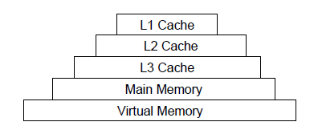
Memory Hierarchy
“Memory” in a desktop computer today is rarely a single monolithic structure.
  Consists of layers, called a “hierarchy”.
    Topmost layer is the fastest, but most expensive and therefore the smallest.
    Bottom-most layer is the cheapest and biggest, but the slowest.
  Each layer above contains a small portion of the layer below:
    Use “replacement policies” to decide which portions to copy.
When you buy a computer with “16GB of memory”, it refers to size of the “main memory” layer.

Slide 4
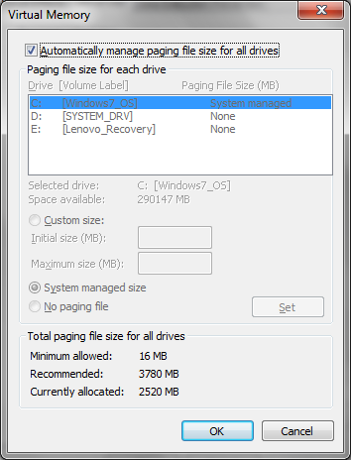
Virtual Memory
Virtual memory is:
  The lowest layer, slowest layer of the memory hierarchy.
    Actually, unlike the rest of memory, VM is not even implemented in silicon!
    It is implemented on your hard disk!
  The layer above (your “main memory”) maintains a copy of a small portion of the VM.

Slide 5
Virtual Memory
Primary motivation:
  Hard disk space is CHEAP! As at 2013:
    Hard disks cost under 1 cent per megabyte.
    DRAM costs 4.8 cents per megabyte.
  Make a portion of the hard disk look like memory to the CPU, so that we can fool the CPU into thinking there’s more memory that we actually paid for!
We can do this by having instructions and data that the CPU is currently interested in, in main memory. Everything else stays on the VM.
  In this way we can squeeze MUCH MORE instructions and data than otherwise possible!

Slide 6
Virtual Memory
Problem:
  The CPU can only execute instructions and access data if it’s in the main memory (actually, only if it’s in the L1 cache, but we’ll overlook that detail).
  But main memory contains only a portion of the VM contents!
Questions:
  How do we map the much larger addressing space of the VM to the smaller space of the main memory?
  What if the CPU tries to read instructions/data that are in VM but not in the main memory?

Slide 7
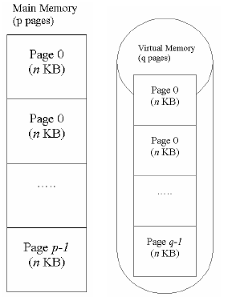
Virtual Memory
Paging.
  VM is divided into fixed equal sized blocks called “pages”.
  Physical memory is divided into “frames” that are the same size as a VM page.
    A “Virtual page” in the VM can be loaded to any “physical frame” in main memory.
  The CPU always generates “virtual addresses”.
    I.e. any CPU address always points to a page in virtual memory.

Slide 8
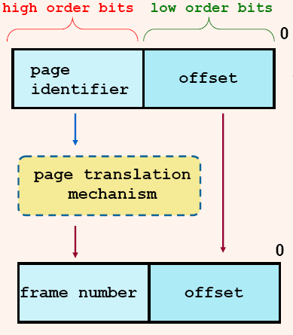
Virtual to Physical Address Mapping
Notes: Virtual Page Number and Page Identifier are the same thing.
Frame number and Physical Page Number are yet again the same thing.
Offset and Byte Index are
also the same thing.

Slide 9
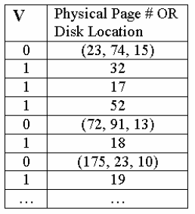
Virtual to Physical Address Mapping
  Specialized hardware on the CPU, together with virtual memory services in the OS, work together to translate “virtual addresses” into “physical addresses” that correspond to locations in main memory.
    This is achieved through a “page table”.
    This is a data structure in main memory created and maintained by the OS.
  V=1 means the information requested is in main memory.

Slide 10
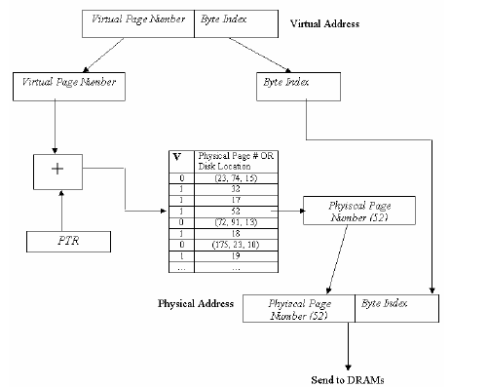
Virtual to Physical Address Mapping
The virtual address forms an index into the page table.
  If the “virtual page” is in memory, a “memory translation” process takes place that locates which frame this virtual page has been loaded into.
This information is used to generate the “physical address” to access main memory.

Slide 11
Virtual to Physical Address Mapping
Given an N bit virtual addressing space, P bit physical addressing space with B byte page/frame size:
  # of bits in offset=log₂(B)
  # of bits in page identifier (or VPN)
  = N-log₂(B)
  # of bits in frame number = P-log₂(B)
So if we have 32KB pages, a 4GB virtual addressing space and 2 GB of physical memory:
  offset =log₂(32KB) = 15 bits.
  Page identifier: log₂(4GB) - 15 = 32-15 = 17 bits.
  Frame number: log₂(2GB)-15 = 31-15 = 16 bits (i.e. each PTE has a 16 bit frame number + 1 valid bit)
There will be 2¹⁷ pages in this system, with 2¹⁶ frames.

Slide 12
Properties of Paging
No external fragmentation.
  Pages that should be contiguous can be mapped to non-contiguous frames.
Internal fragmentation.
  Basic allocation unit is now 1 page. Can be quite large!
Mapping is transparent to programs.
  Programs only “see” virtual addresses.
Can grow process segments by adding more pages.
  Growth is now limited to multiples of one page.

Slide 13
Page Faults
This scheme works if the instruction/data requested is actually in main memory.
If it’s still on the disk:
  The V flag will be “0”. The hardware sees this and generates a “page fault” interrupt.
  This is vectored to a “page fault” ISR within the OS.

Slide 14
Page Faults
The page fault ISR does the following:
  Locates where the missing page is on the disk.
    Easy: When V=0, the page table contains the location on disk where the page is (in cylinder/side/block format).
  Finds a free frame to load the VM page into.
  Updates the page table.
    Set V=1, and changes the entry to show which frame the virtual page has been loaded into.
The VM then goes through the rest of the address translation process to allow the CPU to access the faulting data/instruction.

Slide 15
Page Faults
When should a page be loaded into memory?
  Demand Paging:
    Page is loaded when an access is made to a location inside it.
  Pre-paging:
    Other pages (e.g. surrounding pages) can be loaded together with the fault page.
    Pages can be pre-loaded when a process starts.
  Can be a mix of strategies.

Slide 16
Replacement Policies
What if there are no more free frames?
  We must select data/instructions in one of the frames that is in used to be copied back to VM.
    “Swapping” back to VM.
  The new virtual page is then loaded into the freshly vacated frame.
How do we choose which frame to “swap out”?
  We use “replacement” policies
    FIFO
    Least Recently Used.
    Optimal Page Replacement.
    Clock Replacement
In all these algorithms we only consider PTE entries with V=1.
  Why?

Slide 17
Replacement Policies
FIFO
Principle: First page in = first page out.
  When we are out of frames, we kick out the oldest page.
Example:
  Assume 3 frames, and access string of 2 3 2 1 5 2 4 5 3 2 5 2:
    Pages 2, 3 and 1 loaded into frames 0, 1 and 2.
    When 5 is read in, 2 is kicked out.
    When 2 is read in, 3 is kicked out, etc.
Implementation:
  Use a FIFO queue of pages read in.
  New pages are added to the tail, pages at the head are swapped out when no more frames.

Slide 18
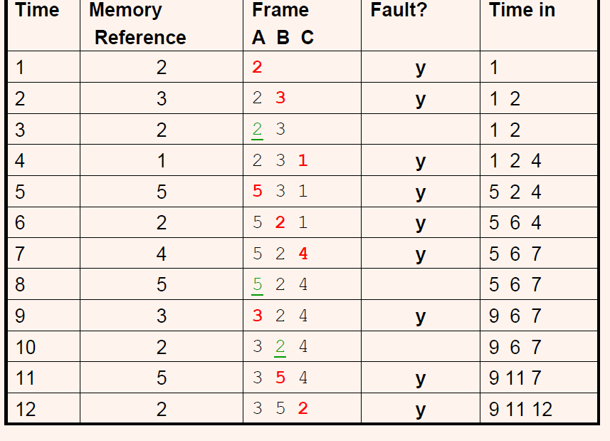
Replacement Policies
FIFO
Total page faults: 9

Slide 19
Replacement Policies
FIFO – Belady’s Anomaly
Belady’s anomaly:
  In a FIFO replacement policy, having more frames can increase paging instead of decreasing it.
  E.g. try 1 2 3 4 1 2 5 1 2 3 4 5 with 3 and 4 frames.
One way to solve this is to consider frequency of use (i.e. temporal locality) instead of age.
  Optimal Page Replacement (OPT), Least Recently Used (LRU) and Clock Replacement (CR).
  None of these suffer from Belady’s Anomaly.

Slide 20
Replacement Policies:
Least Recently Used (LRU)
We can get possibly better performance by replacing a page that hasn’t been used in a while.
  Assumption: If a page has not been used in a while, it’s probably no longer useful and unlikely to be used again anytime soon.
    E.g. An initialization function that is called once and never again.

Slide 21
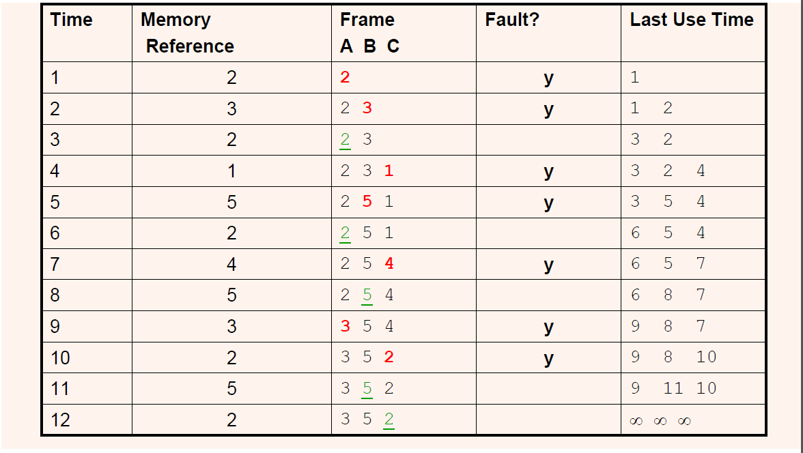
Replacement Policies:
Least Recently Used (LRU)

Slide 22
Replacement Policies
Least Recently Used (LRU)
Implementation:
  Each page table entry (PTE) has an p-bit counter c_{i}.
  At each access to page i, the c_{i} is set to 2^{p} -1.
  Counter for all other pages is decremented by 1.
  When it is time to replace a page:
    Perform a search through page table to find smallest c_{i}.
    Swap that page back to disk.
  If >1 page has smallest c_{i}, choose the first one we encountered.
Note that this is just an approximation of true LRU.

Slide 23
Rewriting Pages to Disk
Pages are large. Writing swapped out pages back to disk is expensive.
Solution:
  Have a “D” (Dirty) bit in each PTE.
  When an address within a page is written to, set D=1.
When a page is chosen for replacement:
  Inspect D.
  If D=1, write it back to disk. Otherwise just replace the page.
Note: requires hardware support to update D.

Slide 24
Thrashing
When the amount of data/instructions in VM is much, much greater than available physical memory:
  Accessing instructions/data might frequently be in pages that aren’t yet in physical memory.
  Shortage of physical memory causes frames to be frequently swapped out to disk.
  The swapped out frames are accessed again, causing other frames to be swapped out so that these can be swapped back in.
This is called “thrashing” and is a performance disaster.
  Your disk light keeps flashing and your computer grinds down almost to a halt.

Slide 25
Thrashing
The following code can cause thrashing.
  Huge array, 4 million bytes.
  If a page has 1024 bytes, this will be spread across almost 4,000 pages.
  Random accesses will likely cause pages to be swapped out and back in again.
  #define N 1000000
  int A[N];
  …
  while(1)
  x=A[random() % N];

Slide 26
Virtual Memory
Translation Lookaside
The page table is in main memory.
  This means TWO accesses to main memory for each CPU memory access:
    One access to consult the page table.
    One access to actually read/write the physical memory.
  Remember that main memory is SLOW!
    Typically 80ns vs 10ns of the L3 cache. L1 and L2 are even faster.
  Solution:
    Use a special high speed memory to store parts of the page table!

Slide 27
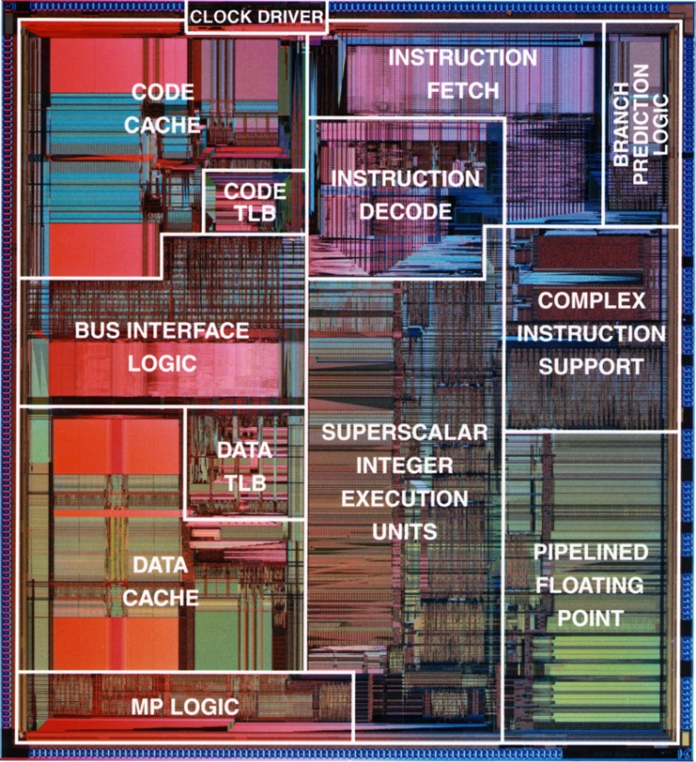
Virtual Memory
Translation Lookaside
This special cache is called the “Translation Lookaside Buffer” or TLB.
  This is often located on the CPU die itself.

Slide 28
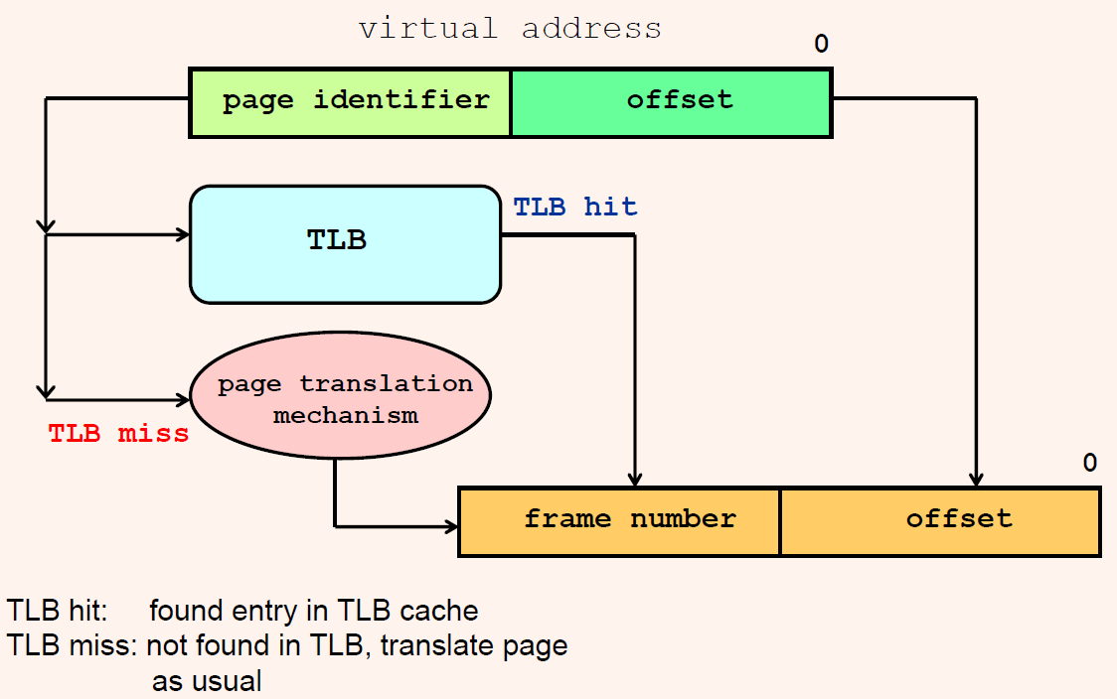
Virtual Memory
Translation Lookaside

